Slide 1
P20
SUMMER CAMP
Notes:
This will slide will stay up on the screen before and after the Weird Al video plays before we start.

Slide 2
OCP P20 Summer Camp
“Back to School 2017”
Notes:
Welcome everyone!

Slide 3
OCP P20 Summer Camp
“Back to School 2017”
Adam Grocholski
Peter Laudati
Freestyle
Freestyle
Notes:
Adam & Peter intros

Slide 4
Homeroom Agenda
Welcome & Intros – Adam & Peter
Executive welcome – Scott Emigh
LT Welcome – Tony Surma & Leslie Pickering
Summer Camp Agenda Overview – Adam & Peter
P20 Program Overview – Tony Surma
Logistics – Adam & Peter
Notes:
Welcome to homeroom… where we take attendance and make all the announcements, say the pledge of allegiance, etc.

Slide 5
OCP P20 Summer Camp
“Back to School 2017”
Notes:
For the past two years, the DX organization has held a technical readiness event called “Summer Camp” each August in beautiful Sandusky OH.
These events were… blah blah blah.
This year, Summer Camp is bigger than ever. We had to scale it from 50 people up to 150 people!
A big team formed to bring this week’s event to you.
There was a lot of spirited discussion in shaping this event.
But the first and totally unanimous decision was….

Slide 6
OCP P20 Summer Camp
“Back to School 2017”
Notes:
…we’re NOT going back to Sandusky!
Sorry Buckeyes! :/ Love your state, but time for a change.

Slide 7
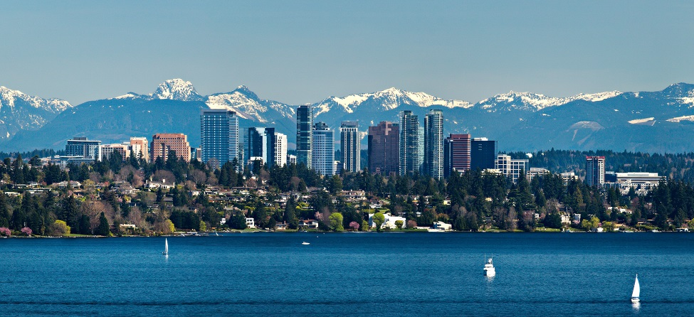
OCP P20 Summer Camp
“Back to School 2017”
Greetings from Bellevue, WA
Notes:
So we brought you all here to lovely Bellevue, WA!
As most of you know, we’ve gone through a lot of changes as a company this summer, so planning this event for August didn’t quite work out.

Slide 8
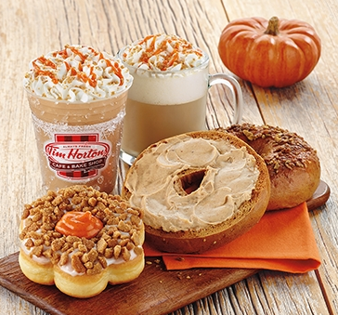
Notes:
It doesn’t FEEL like summer?!
The smell of pumpkin spice latte is in the air!
Not just here… but on the east coast (dunkin & wawa)
Time for all the Pumpkin Beers!
And, um…. Ugh… Pumpkin Cheerios?!!!
(My kids snuck this stuff into my house, and yes… it is a guilty pleasure.)
And it’s not just pumpkin season in the US… our neighbors to the north are pumpkin crazy too (Tim Hortons)
BUT… we’re STILL keeping the name Summer Camp!!!

Slide 9
Notes:
Summer doesn’t end until Summer camp is over on Friday!
Science is on our side!

Slide 10
Notes:
Speaking of all those colorful leaves we’re starting to see…

Slide 11
Notes:
I wanted to call attention to some red maple leaves in the room!
Hey OCP Canada! Stand up!
For those of you playing the game… remember who these folks are! It’ll come in handy.

Slide 12
Notes:
I don’t want to hear the word “land”, “landed”, or “landing” ever again unless it is used in a context like this scenario
This is a TECHNICAL event!
And to have some fun…

Slide 13
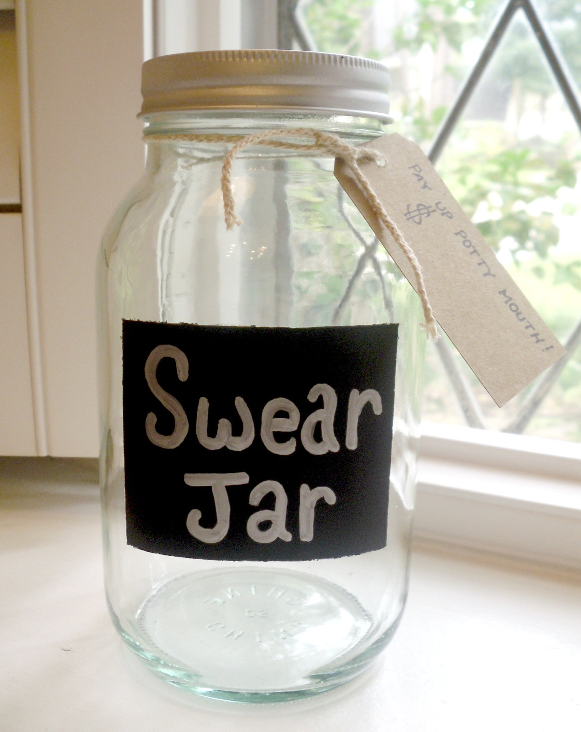
Buzzword Swear Jar If you say it, you pay it!
Land, landed, landing!
Pivot
Building the plane while flying it
Flywheel
Full Stop
At the end of the day
Synergy
Super Excited
Notes:
We’re going to have a Buzzword Swear Jar!
I’ve got a few Microsoft buzzwords listed here.
Let’s hear a few of your pet peeves audience???
Edit the slide live

Slide 14
Buzzword Swear Jar If you say it, you pay it!
All speakers, especially the LT, must put $ in the jar anytime someone in the room calls them out on it!

Slide 15
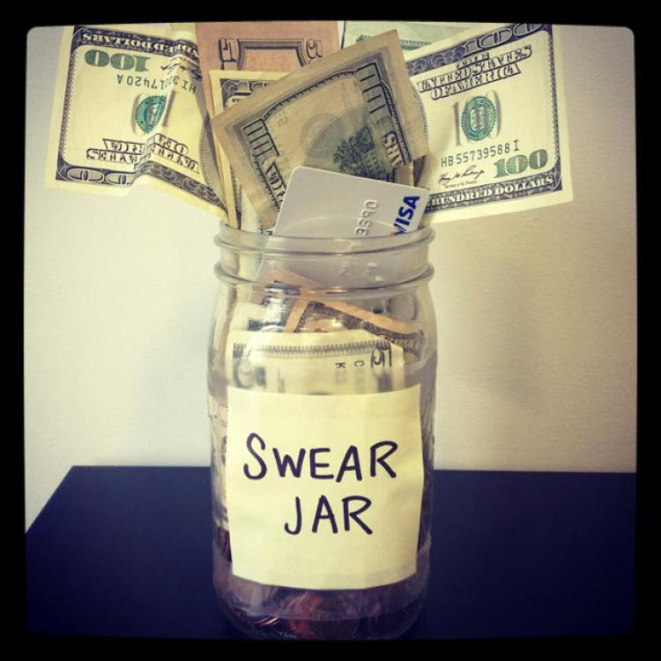
Buzzword Swear Jar What will we do if it gets filled?
All “buzzword” funds will be matched by http://give & donated to support those impacted by Hurricanes Harvey & Irma.

Slide 16
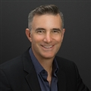
Executive Welcome
Scott Emigh
Buzzword Exec

Slide 17
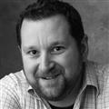
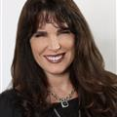
Leadership Team Welcome
Tony Surma
Leslie Pickering
Leadership
Leadership

Slide 18
P20 Summer Camp Syllabus
Date | Subject
Tuesday 9/19 | Modern Workplace 201
Wednesday 9/20 | Azure Infrastucture 201 Azure Apps 201
Thursday 9/21 | Business Applications 201 Data & AI 201

Slide 19
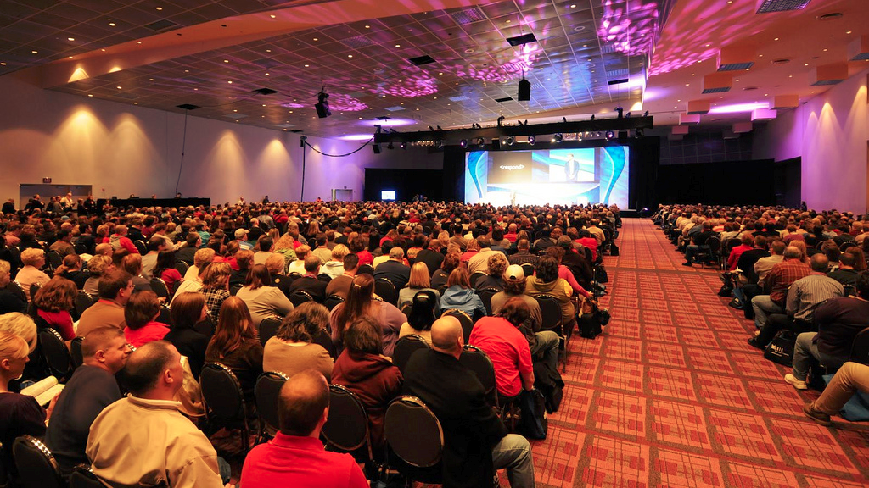
1st & 2nd Periods: General Sessions

Slide 20
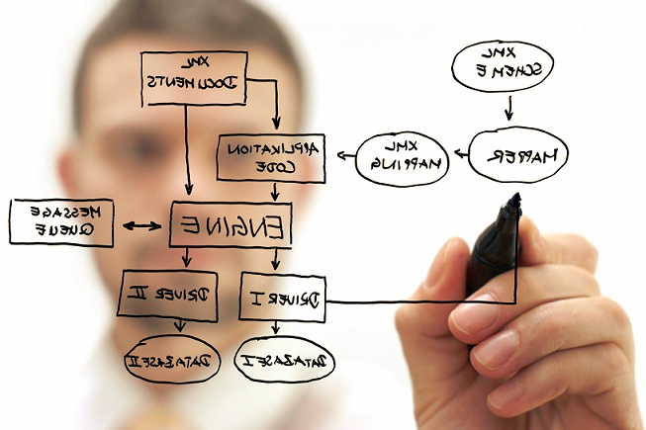
3rd Period: Solutioning
Work with your team
Read the scenario(s)
Break out the sharpies!
Let the flip boarding begin
Be as neat as this →

Slide 21
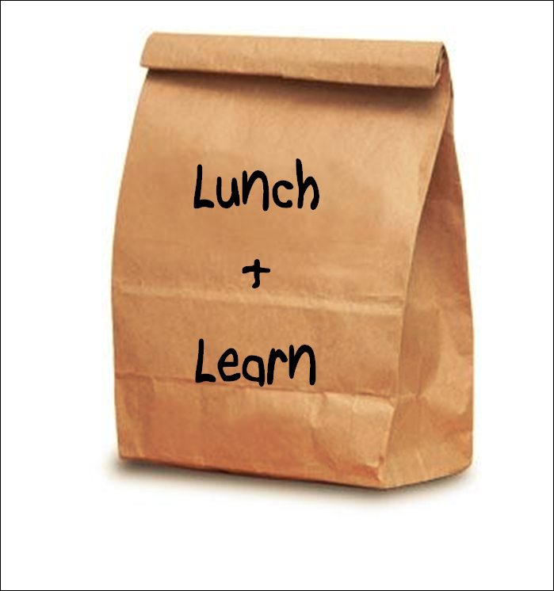
4th Period: Lunch -n- Learn
Food! Glorious food!
(It won’t be in a paper bag)
Network
Learn something

Slide 22
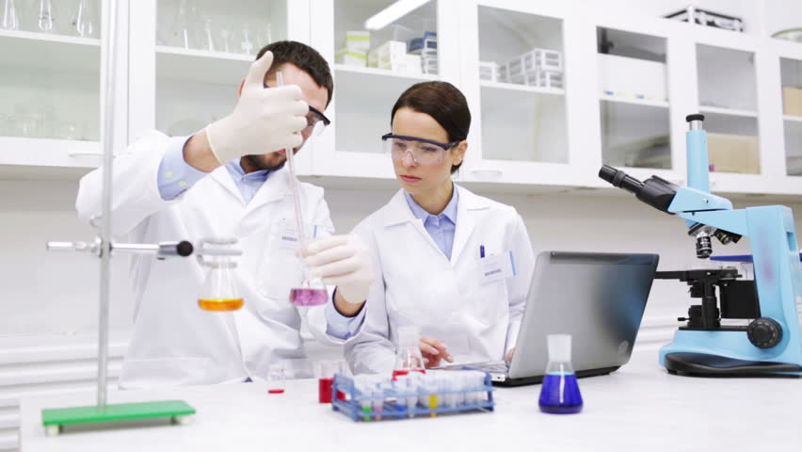
5th Period: Laboratory
Experience the technology
Get hands-on
Share, Learn with, and Learn from your teammates
Try new things for the first time*

Slide 23
6th Period: Electives*
Elective #1: Partner Technical Strategy
Back to the flip boards
Discuss how to apply technology to business
Elective #2: Broad Technical
MORE technical exploration
“Hang with the Experts”
* = Must choose at least one!

Slide 24
P20, Culture, & Mission
Tony Surma
Chief Herder

Slide 25
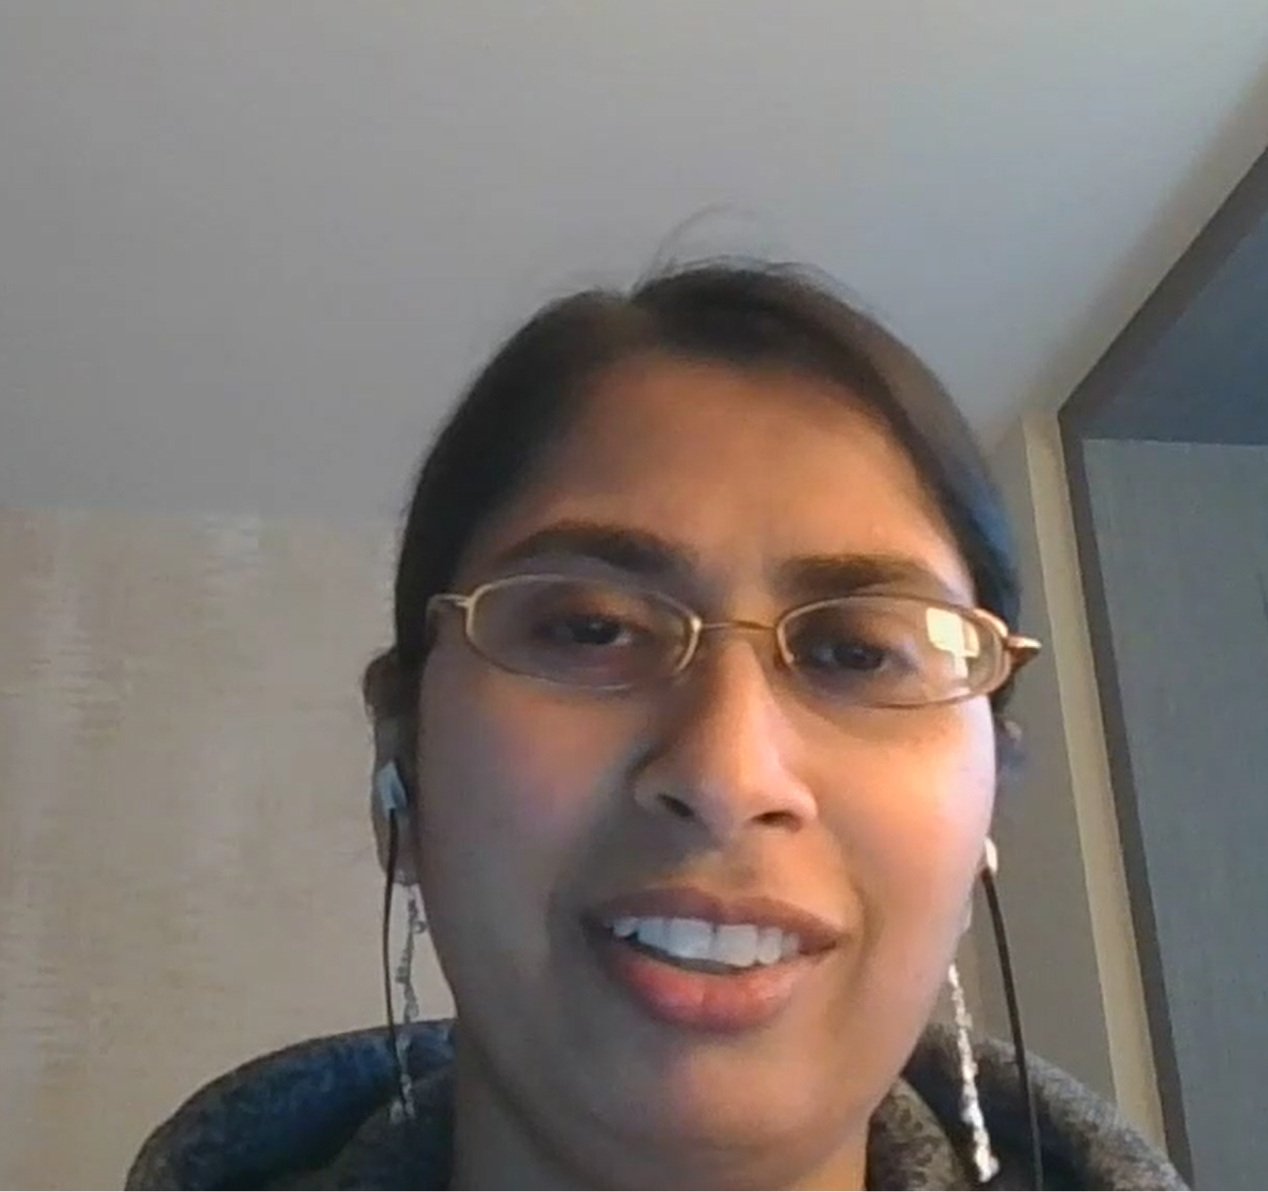
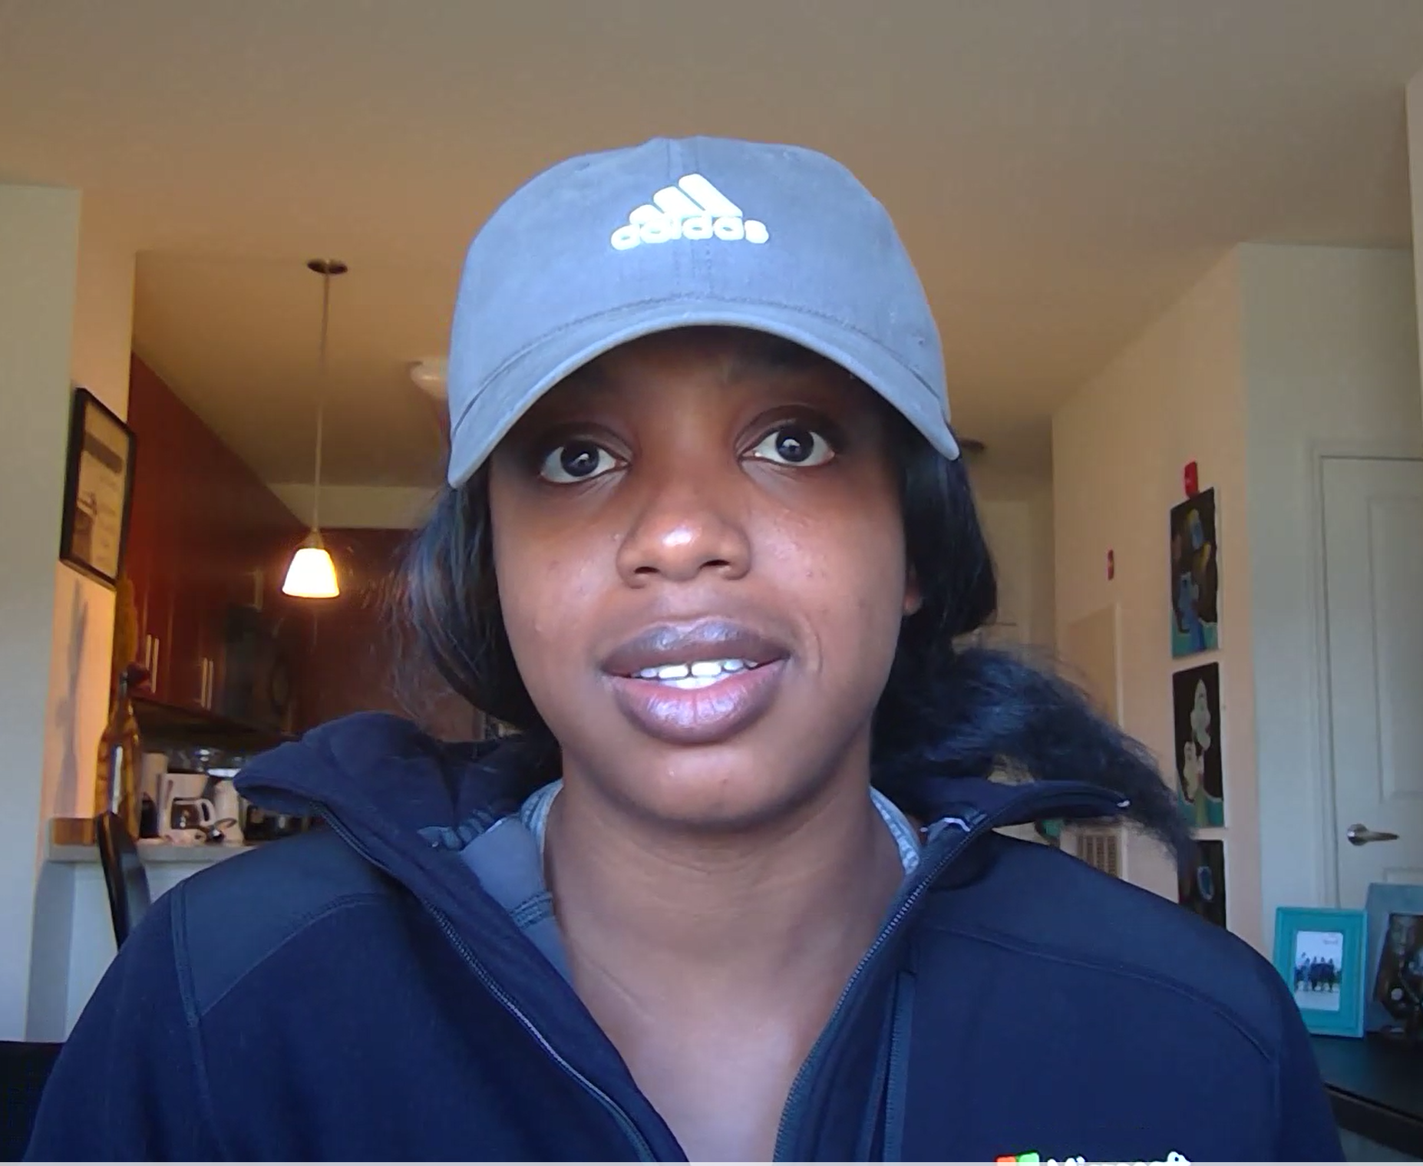
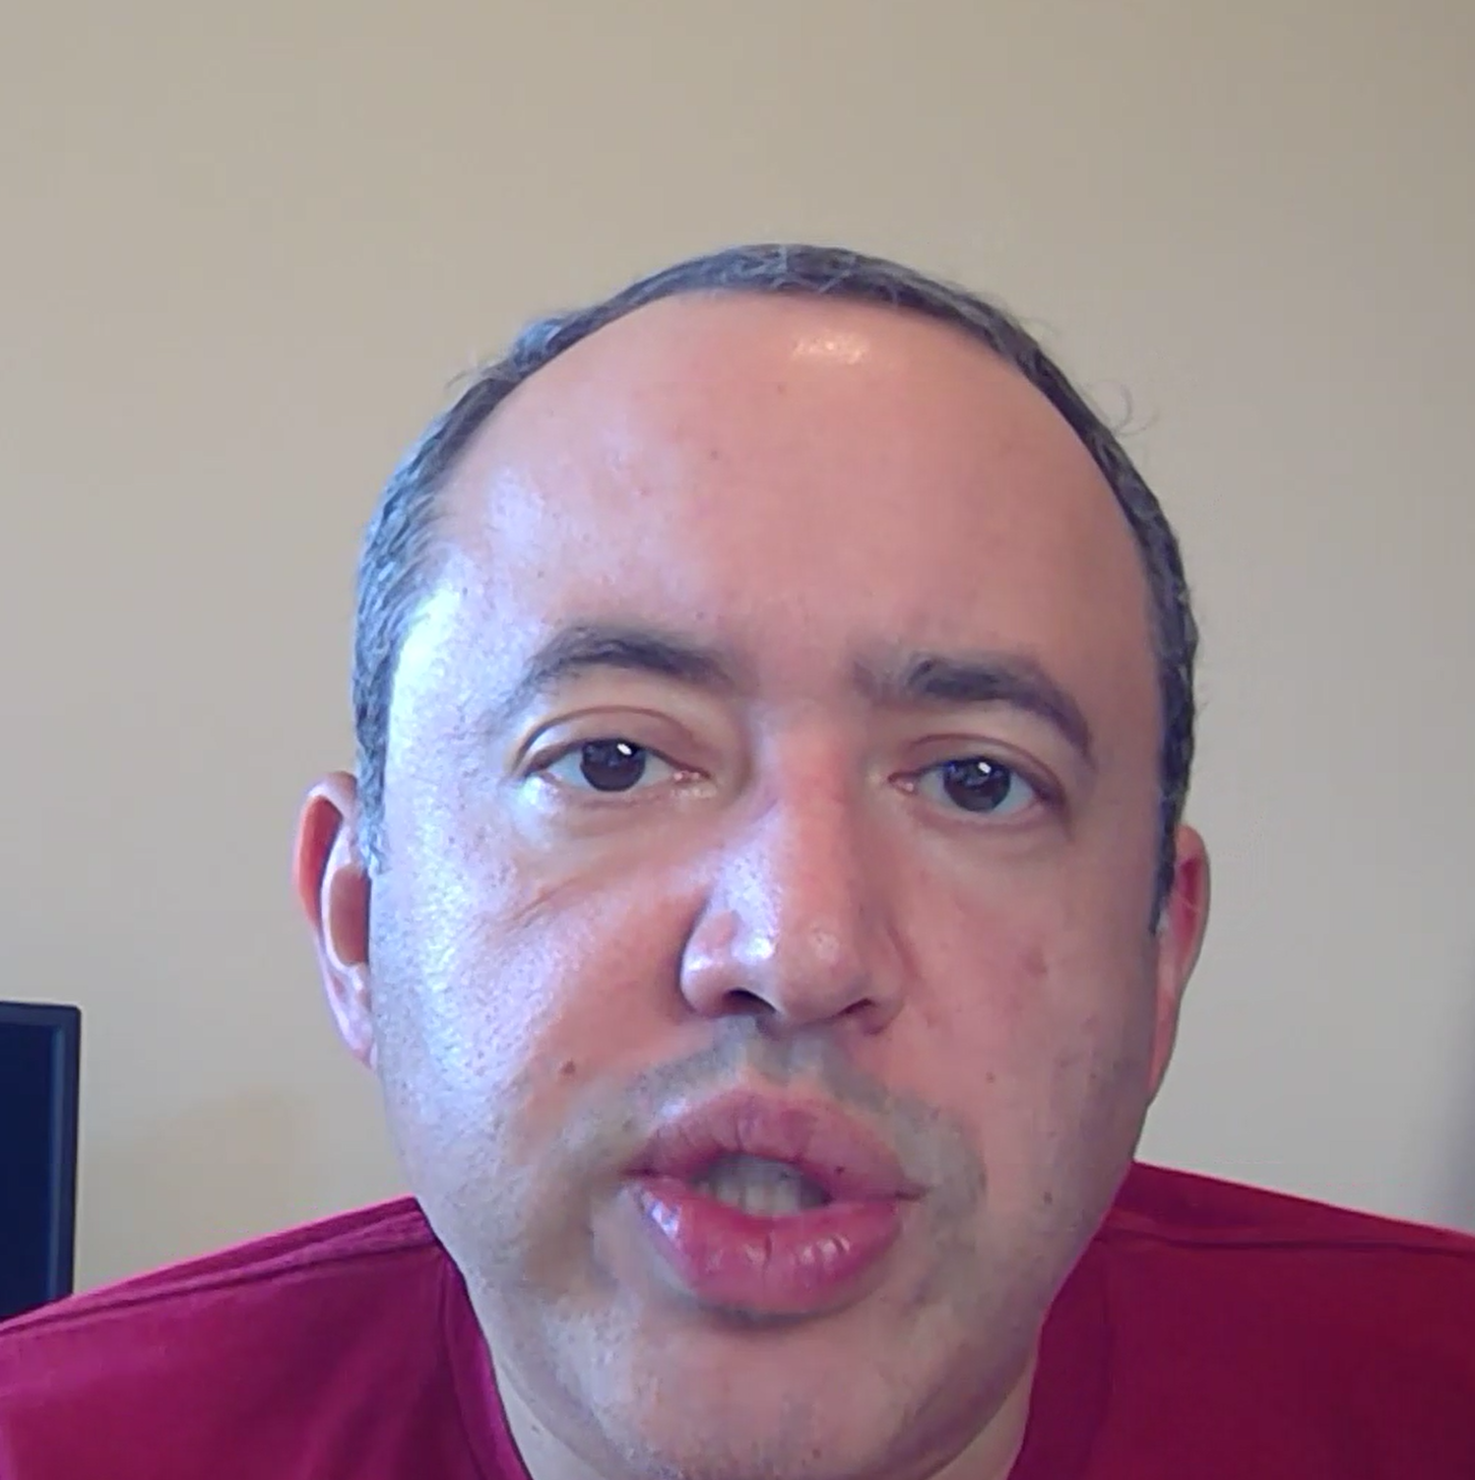
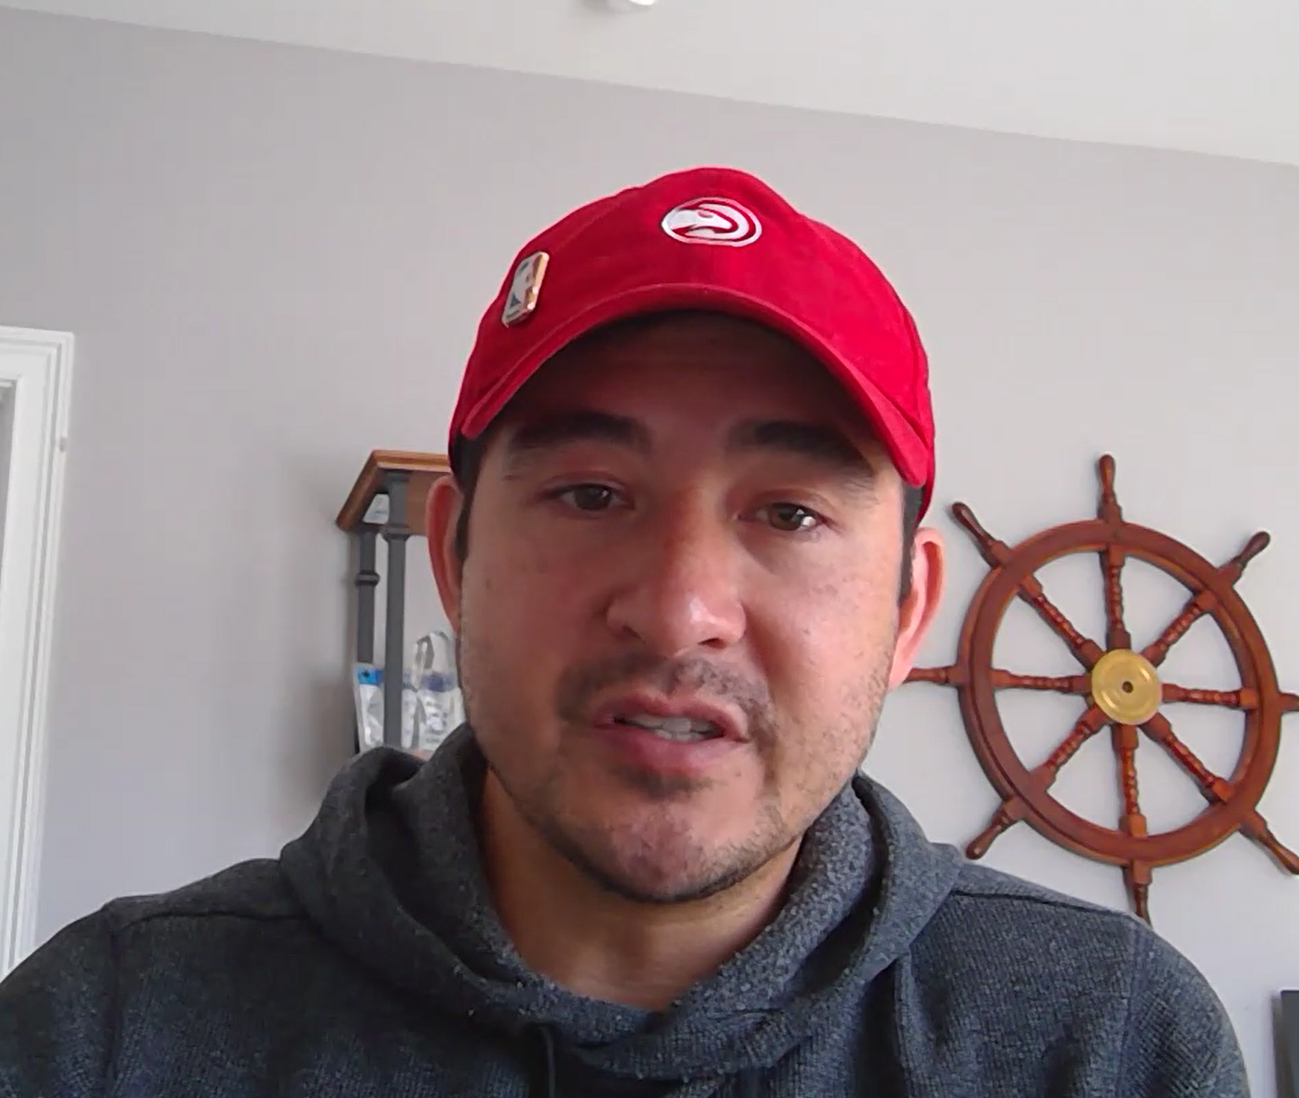
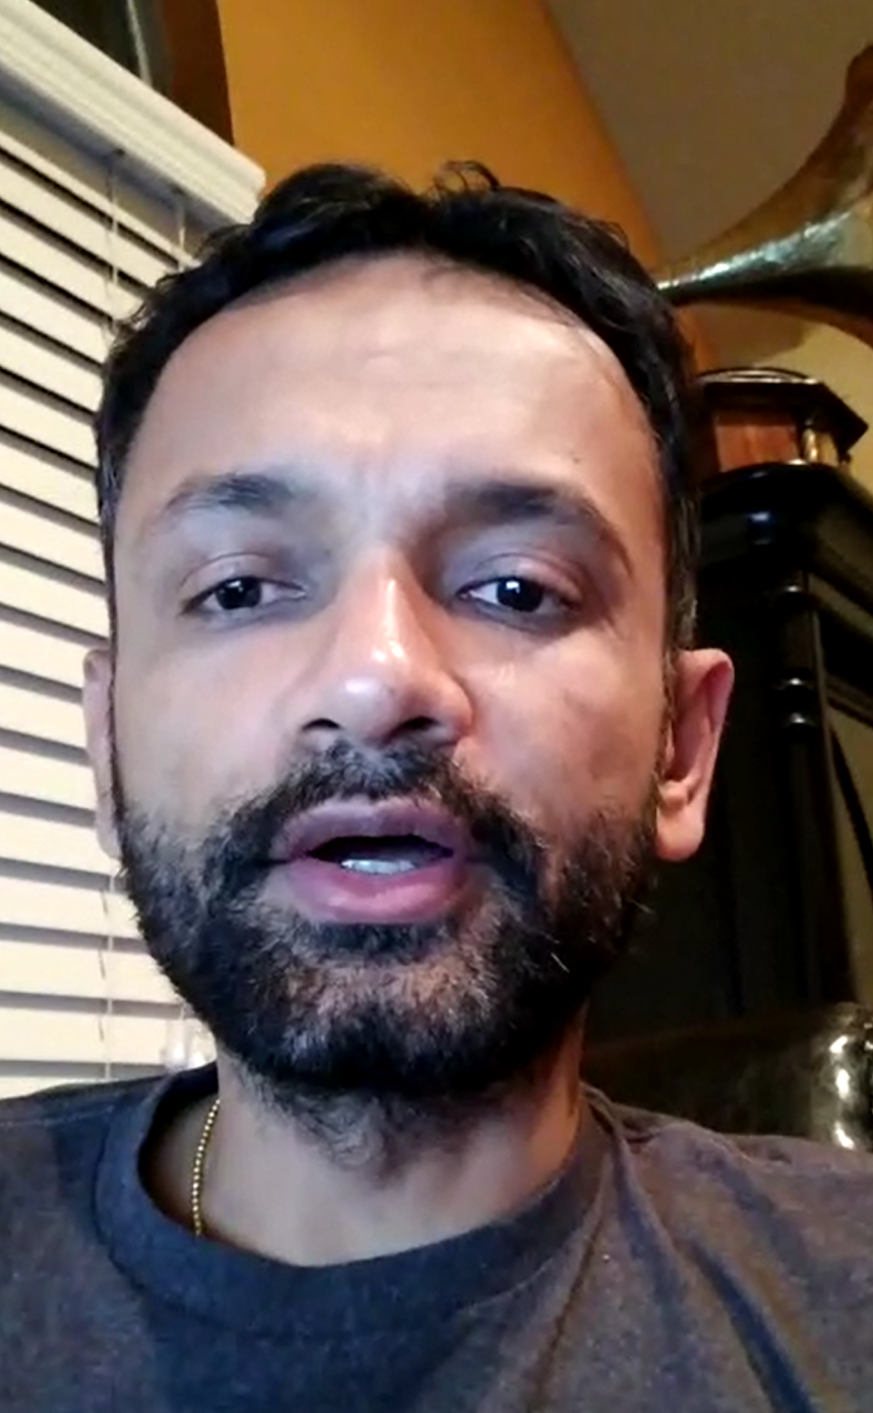
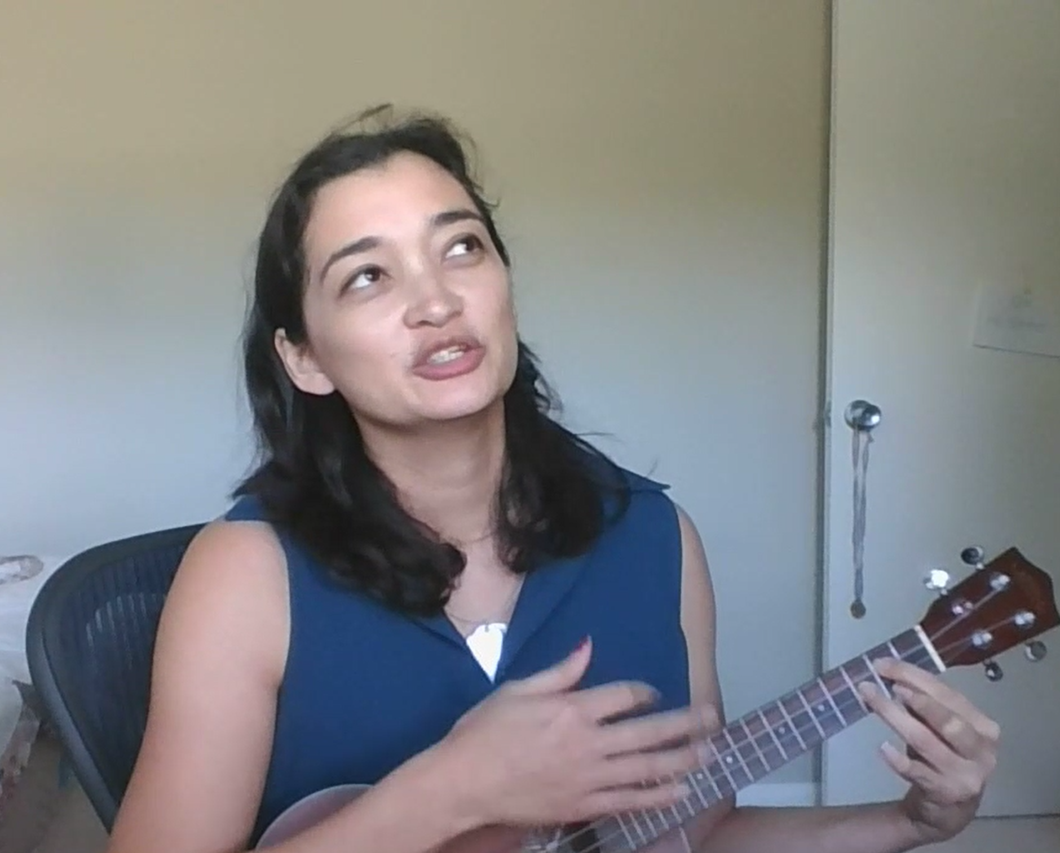
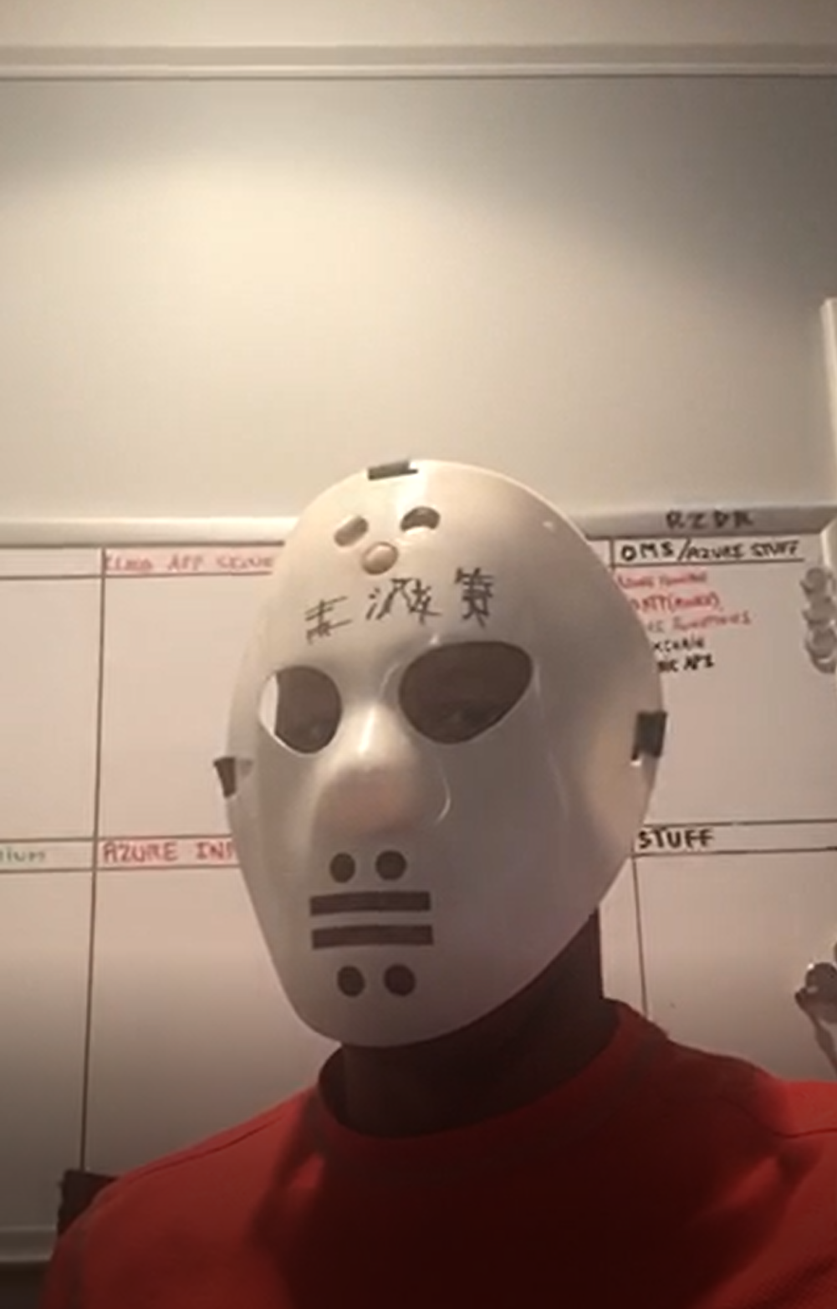
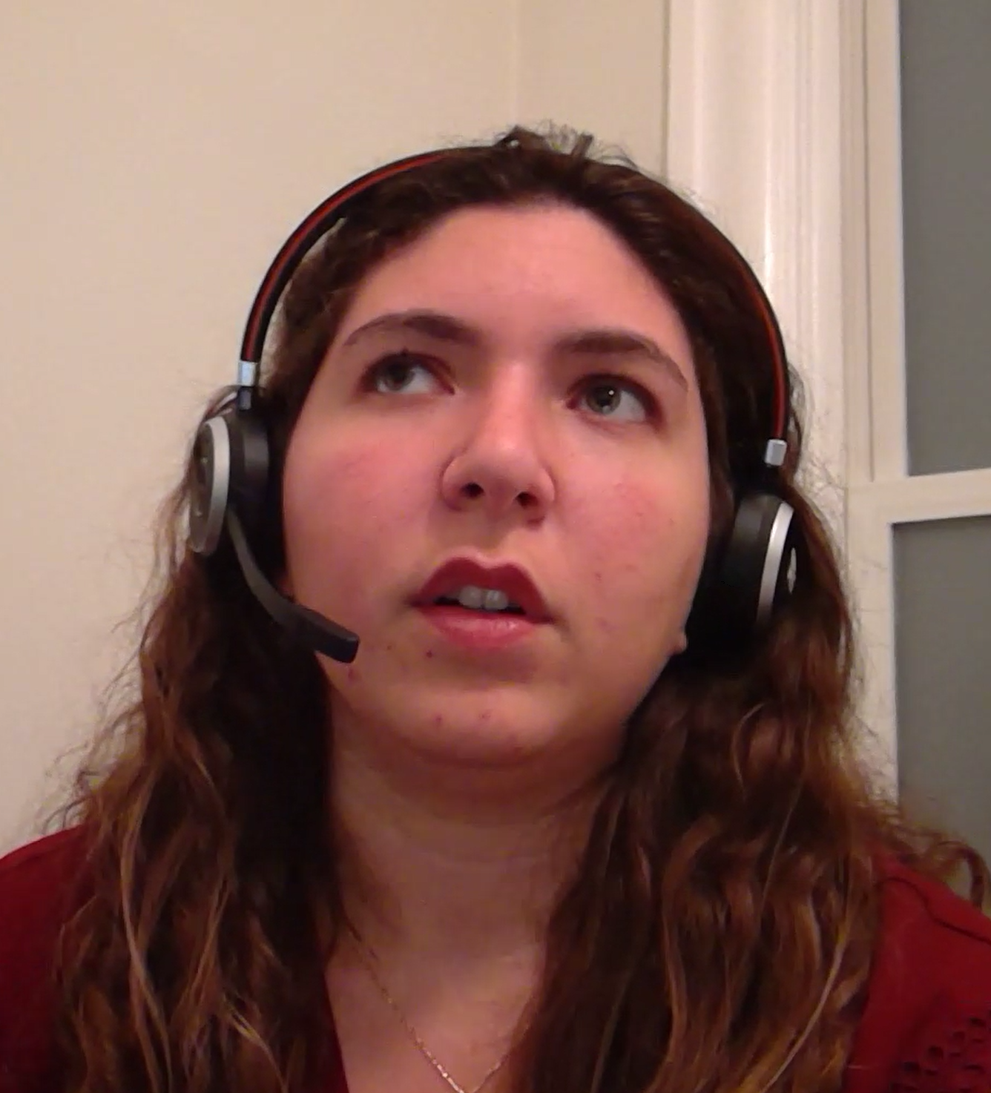
Thank you!

Slide 26
Our Strategy
Attract, Retain, and Develop the Top Technical Talent in the Company.
P20 Mission
Continuous Investment and Commitment to Technical & Engagement Excellence in our careers & passions and as trusted leaders to our partners, Microsoft & the industry.

Slide 27
Growth Mindset
Fixed Mindset leads to
a desire to look smart and
therefore a tendency to avoid
challenges, give up easily, see
failures as fruitless or worse, ignore
useful negative feedback and feel
threatened by the success of others.
Growth Mindset leads to a desire to learn and therefore a tendency to embrace challenges, persist in the face of setback, see failures as essential to mastery, learn from criticism and find lessons and inspiration in the success of others.
Notes:
We want to grow a NEW culture for this NEW organization.
Think about what that means
Our goal is to attract, retain, and grow…
We can’t do that without having a Growth mindset, etc, etc.

Slide 28
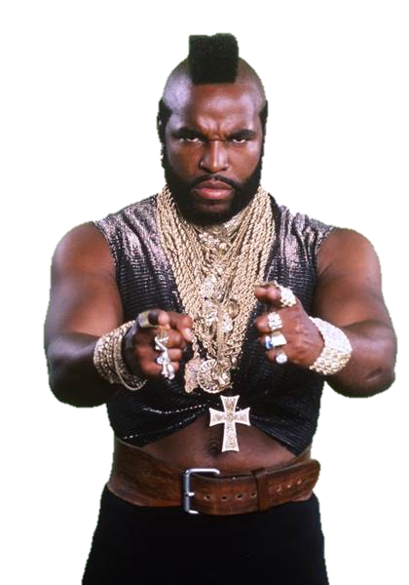
Containers
L400+
Capability Level
L300
Infra & Mgmt
L200
Modern Workplace
Business Apps
Apps & Infrastructure
Data & AI
Technology & Solution Area

Slide 29
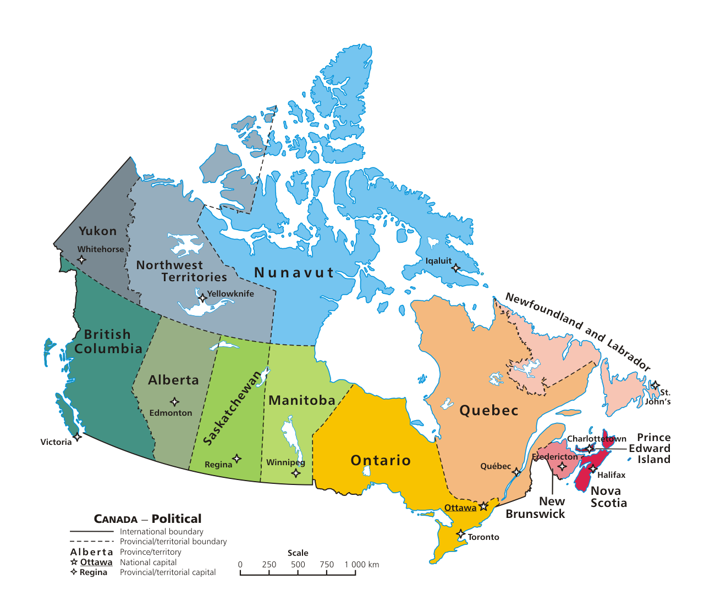
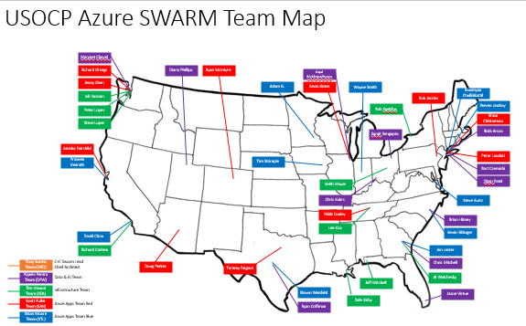
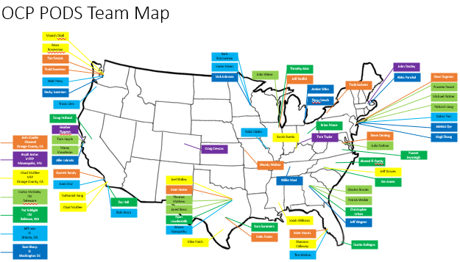
Our OCP Organization
Notes:
We are a new organization that is spread out across a lot of teams and a wide geography.
We don’t have a nice map of where our Canadian peers live, but we do have a nice map of the 13 provinces!

Slide 30
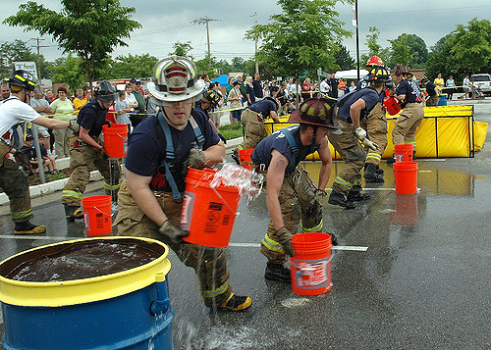
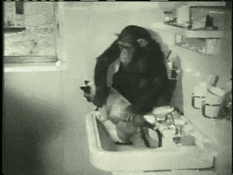
No, just… NO!
Notes:
Well… NO! This is NOT our org chart!
We are gathered here today because…

Slide 31
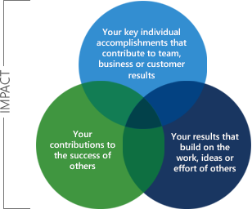
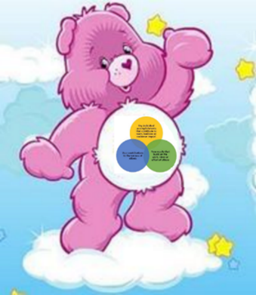
Circles of Life Individual Results are important yet…
Learning from others is IMPORTANTer!
Sharing is caring & is IMPORTANTest!
Notes:
We want our culture to live the new company values.
You probably have seen the “circles of live” or “circles of your connect”
The sharing & learning circles are vital to our success and will drive our culture

Slide 32
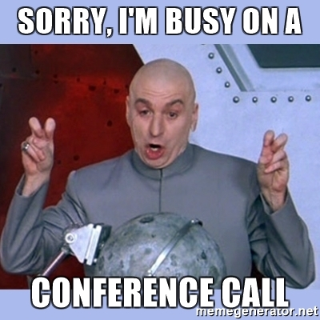
This week is all about us!
Focus and Be Present
If it’s not on fire, put email & phones aside!
This is about growing OUR technical & engagement skills together
This is about meeting new teammates
Make friends. Learn who knows what.
Work on your circles: Help others! Learn from others!

Slide 33
EXCELLENCE & READINESS
B I N G O
L200 MW
Operating Model
Orche-stration
Partner Strategy
Leader-ship
Inno-vation
L200 BizApps
Service Enable-ment
Offering Develop-ment
Delivery
RoleEx
Core Priorities
Score Card
Comp
YOU
Pricing, Licensing, & CSP
L300 Major
Compli-ance
L200 Apps & Infra
Peer Network
L400 Major
Community
Architecture
Mentoring
L200 Data & AI

Slide 34
EXCELLENCE & READINESS
B I N G O
L200 MW
Operating Model
Orche-stration
Partner Strategy
Leader-ship
Inno-vation
L200 BizApps
Service Enable-ment
Offering Develop-ment
Delivery
RoleEx
Core Priorities
Score Card
Comp
YOU
Pricing, Licensing, & CSP
L300 Major
Compli-ance
L200 Apps & Infra
Peer Network
L400 Major
Community
Architecture
Mentoring
L200 Data & AI

Slide 35
P20 Formula
Learn + Do = I Grow
(Learn + Do) x Share = We Grow
Notes:
We want our culture to live the new company values.
You probably have seen the “circles of live” or “circles of your connect”
The sharing & learning circles are vital to our success and will drive our culture

Slide 36
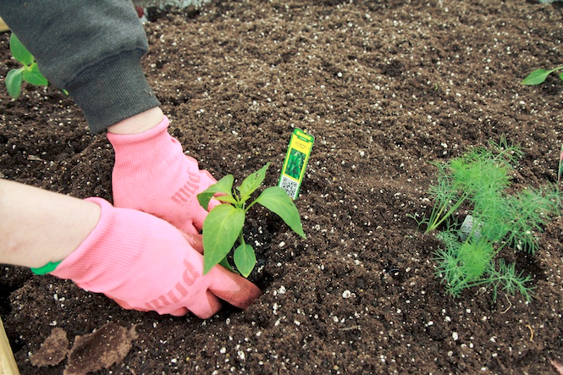
This just the start

Slide 37
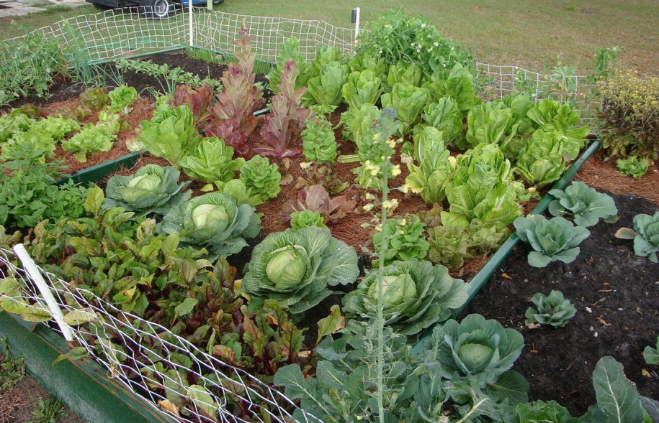
*results may vary
Notes:
You might not grow a garden like this… but at least you can learn while trying.

Slide 38
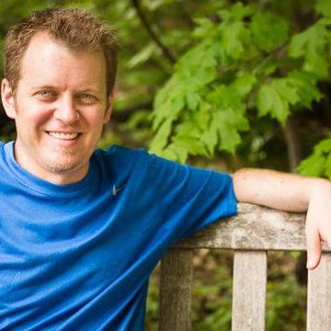
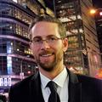
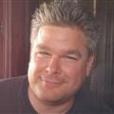
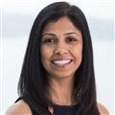
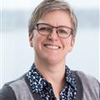
Thank you !_ _
Chief Wranglers:
Adam Grocholski and Peter Laudati
Summer Camp Subject and Content Leads:
Rishi Arora, Sarah Barela, David Branscome, Sriram Ganapathy
Logistics & Venue:
Jodi Solomon
Travis Guinn, Matt Hester, Kevin Hillinger, Nick Johnson
LT Sponsor:
Scott Fuller
Renato Leite, Chris Mitchell, Mike Patch, Mike Richter
Sam Surana, Jeff Wagner, Shawn Weisfeld
Harsha Bennur, Karen Moen

Slide 39
Logistics

Slide 40
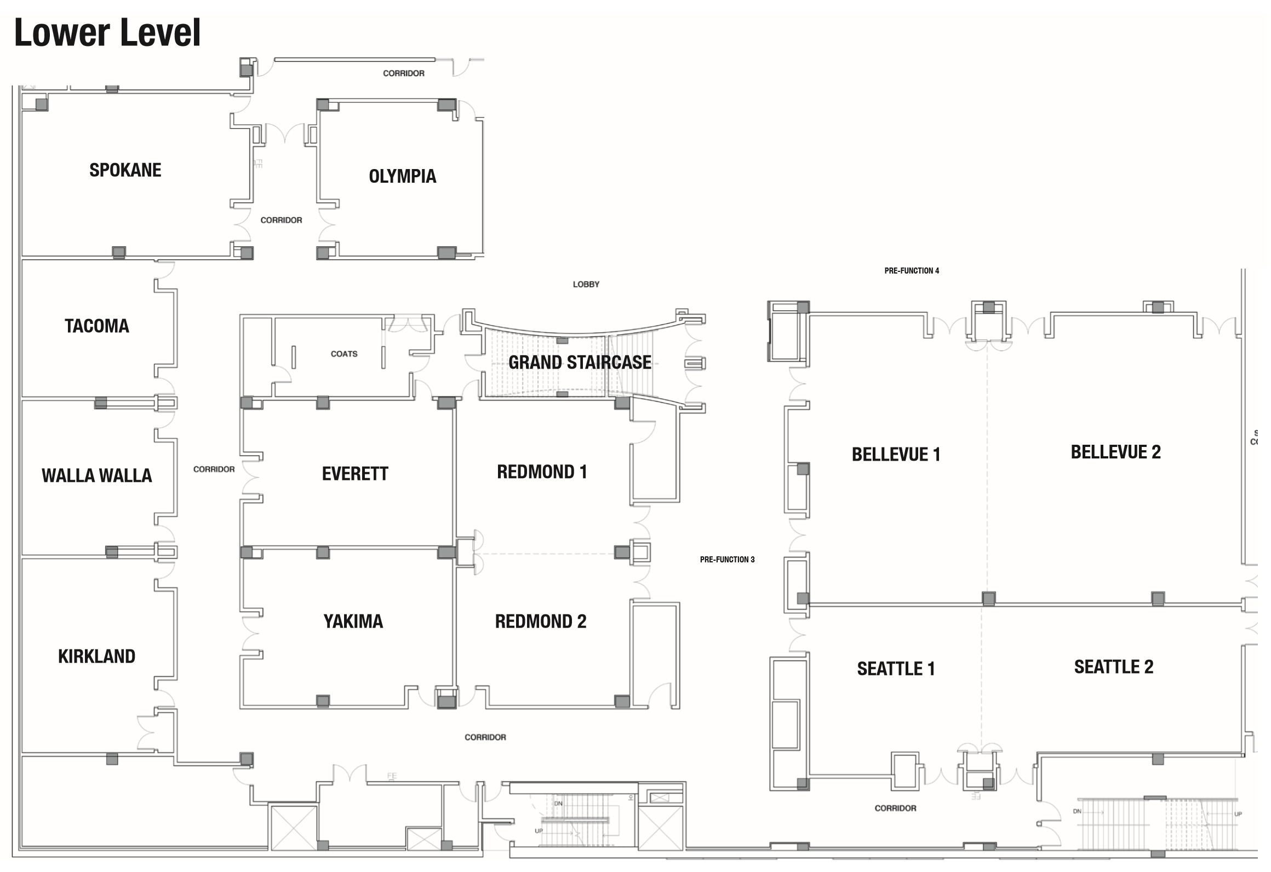
General Sessions
Lunch-n-Learn
Solutioning
Laboratory
Partner Technical Strategy
Solutioning Laboratory
FOOD
Solutioning
Laboratory
Ask-The-Experts

Slide 41
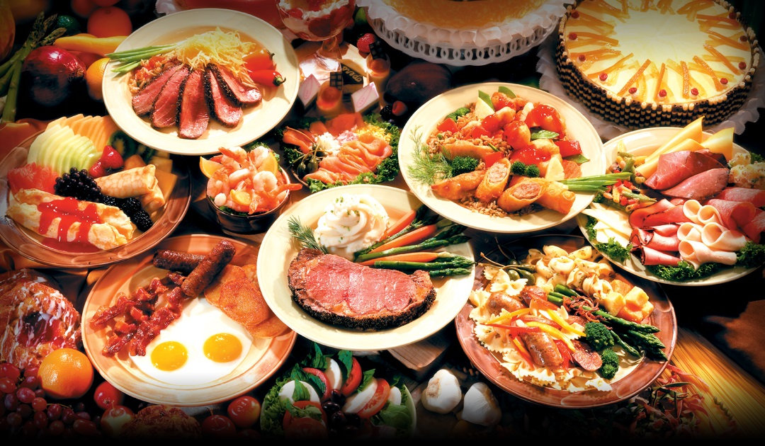
Logistics Food
Notes:
Plenty of food… all of the time…
Breakfast – “Pre-function 3”
Mid-morning Snacks
Lunch – “Pre-function 3”
Afternoon Snacks
COFFEE – ALL DAY!!!
Dinner – Washington 2, 3, & 4
Dinner upstairs today and Wednesday. Thursday will be slightly different…

Slide 42
Logistics Thursday
Notes:
Mention Happy New Year to our Jewish friends and colleagues who observe starting on Wednesday night.

Slide 43
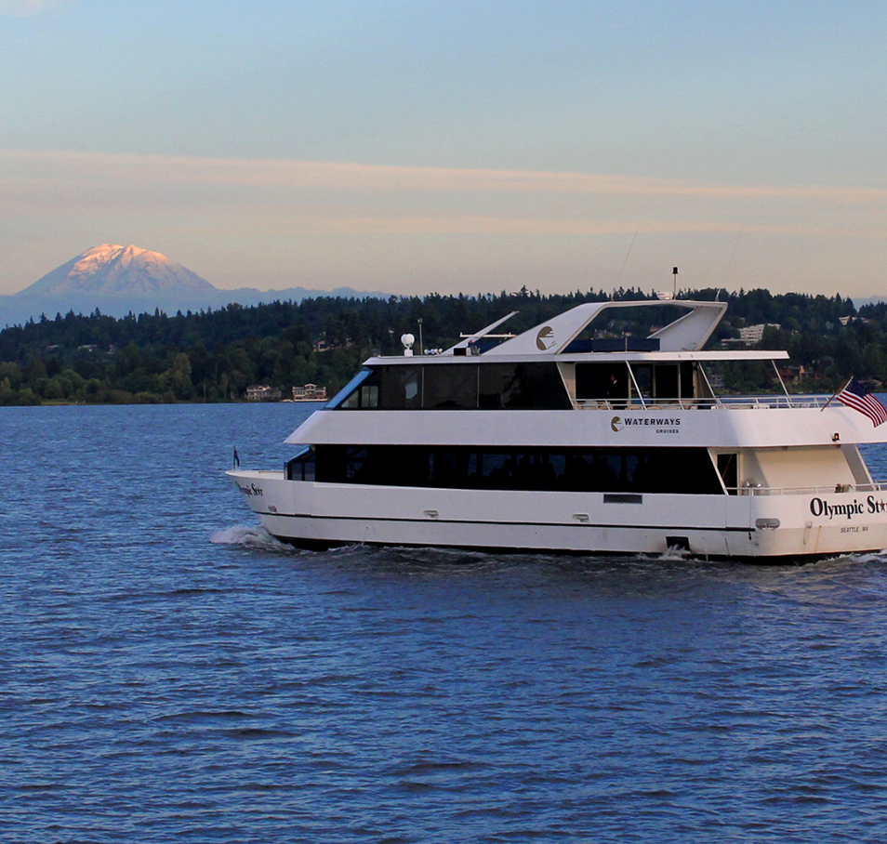
Logistics Thursday – Dinner Cruise
Set your alarm 30 mins EARLIER!
8:30AM START 1st Period!!!
5:00-5:30 – Commencement
5:30-6:00pm – Load Buses
6:30-7:00pm – Get drink tickets from your hosts before boarding!
7:00-10pm – Cruise
10pm – Bus back to hotel

Slide 44
Logistics TGI Friday!
7:30-9:00am – Breakfast here @ Marriott
9:00am-12noon – Team Meetings @ various Bellevue, Wa locations
See your manager to find your location for Friday
Check out and stow your bags with Concierge
Bring bags with you if leaving directly for the airport at noon
12:00pm – Departures

Slide 45
Logistics Miscellaneous
Wifi: sunny2017
Content Repo & Schedule: https://aka.ms/FY18OCPSummerCampLinks
Notes:
This will go on the Flipboards!

Slide 46
WIT & MACH Breakfasts
WIT Breakfast – Wed – 730-9
MACH Breakfast – Thurs – 7-830

Slide 47
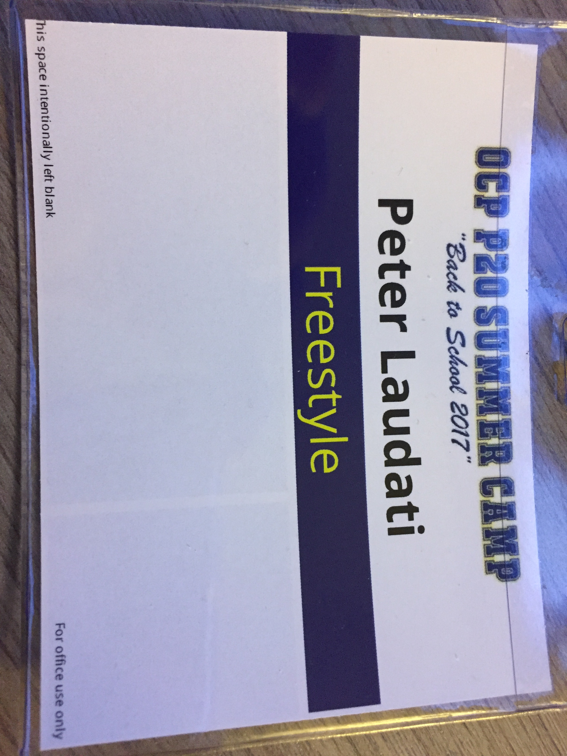
Game On!
Azure IaaS
OSS on Azure

Slide 48
Logistics Saved By The Bell
Save questions for “Hang with the Experts”
Raise your hand to go to the restrooms
When the bell rings, move to the next period!

Slide 49
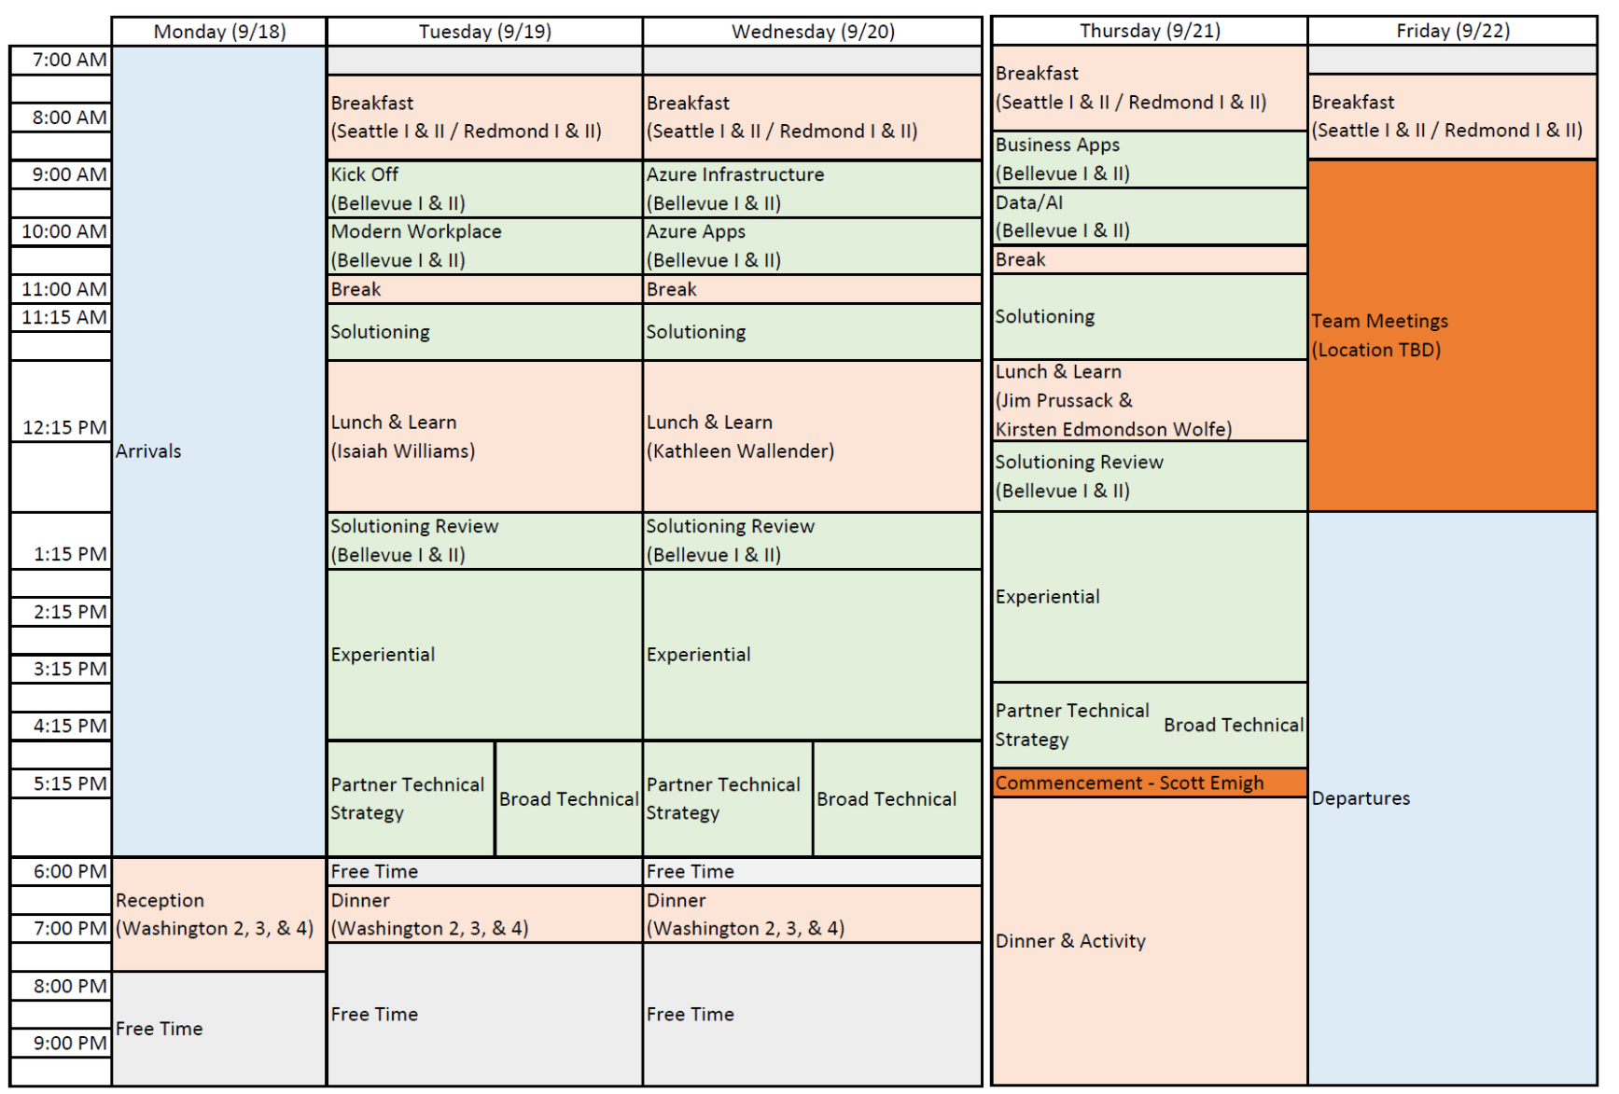

Slide 50
P20, Culture, & Mindset
Tony Surma
Chief Herder

Slide 51
New Organization
Notes:
We are a new organization that is spread out across a lot of teams and a wide geography.
We don’t have a nice map of where our Canadian peers live, but we do have a nice map of the 13 provinces!

Slide 52
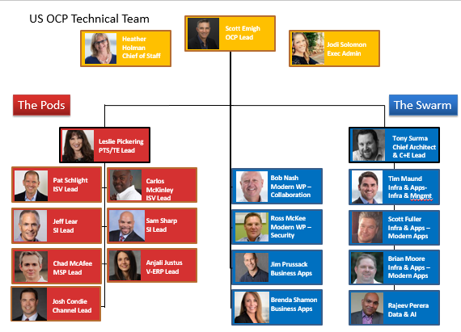
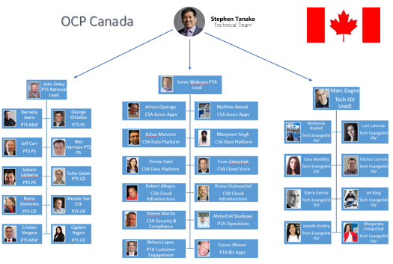
New Organization
Notes:
Our new OCP TT is a large organization of people who have come together from many different organizations…
Diverse customer segments.
Diverse skill sets.
Diverse rolls

Slide 53
New Organization, new anxieties?
Notes:
With any re-org, especially of the scale we all have just gone through, there can be new anxieties.
Does this org chart look more familiar to our veterans?

Slide 54
No, just… NO!
Notes:
Well… NO! This is NOT our org chart!
We are gathered here today because…

Slide 55
We are ONE CP TECHNICAL Team!
Notes:
We’re ONE team...
Blah blah blah…
If you look at your name badges, you’ll notice that they purposely do NOT have your role or team name on them.
Only the “teams” we have created using our advanced machine learning algorithms to match you up with folks you probably haven’t met or worked with before.
(At least Adam tells me he used AI & ML)

Slide 56
Culture & Growth Mindset
Goal: To attract, retain, and grow the best technical talent in the company!
Fixed Mindset leads to
a desire to look smart and
therefore a tendency to avoid
challenges, give up easily, see
failures as fruitless or worse, ignore
useful negative feedback and feel
threatened by the success of others.
Growth Mindset leads to a desire to learn and therefore a tendency to embrace challenges, persist in the face of setback, see failures as essential to mastery, learn from criticism and find lessons and inspiration in the success of others.
Notes:
We want to grow a NEW culture for this NEW organization.
Think about what that means
Our goal is to attract, retain, and grow…
We can’t do that without having a Growth mindset, etc, etc.

Slide 57
Circles of Life Scorecard is important, BUT…
Sharing is caring is IMPORTANTer!
Learning from others is IMPORTANTer!
Notes:
We want our culture to live the new company values.
You probably have seen the “circles of live” or “circles of your connect”
The sharing & learning circles are vital to our success and will drive our culture

Slide 58
This week is all about YOU, not your customers!
Focus
If it’s not on fire, put email & phones aside!
Stay in the moment
This is not about what team you’re on, what role you’re in, or what customer segment(s) you work with.
This is about growing YOUR technical skills
This is about meeting your new teammates
Make friends. Learn who knows what.
Work on your circles: Help others! Learn from others!

Slide 59
Get your hands dirty

Slide 60
Notes:
You might not grow a garden like this… but at least you can learn while trying.

Slide 61
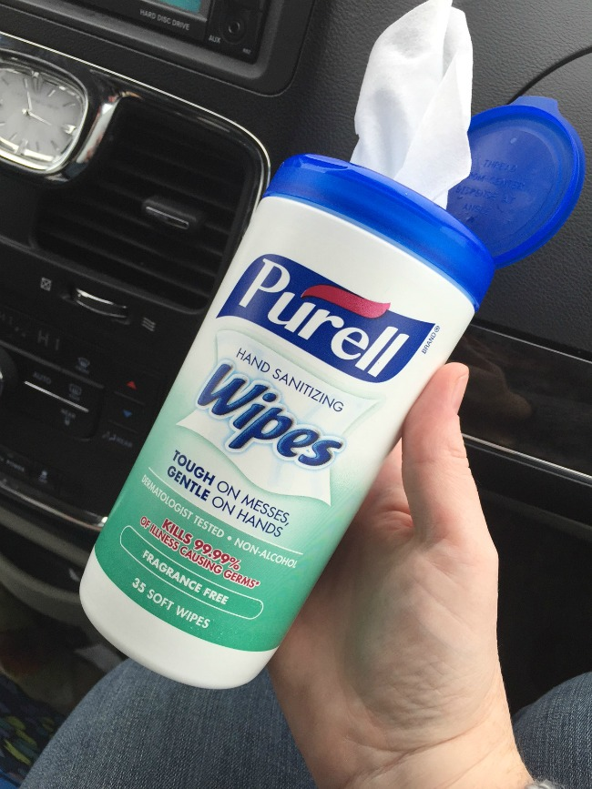
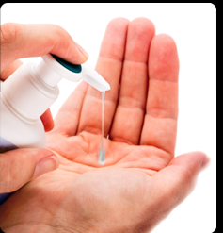
Help each other, Learn from each other
Notes:
And don’t worry… learn from your peers.
They will help you!
And we WILL have Purell on hand for when you’re done here!

Slide 62
P20 Program Overview
History & Goals
Activities
Summer camp (breadth)
Sprints (depth)
v-Hackfests (depth)
Community (sharing)
Teams Site (sharing)
Solutioning Office Hours

Slide 63
EXCELLENCE & READINESS
B I N G O
L200 MW
Operating Model
Orche-stration
Partner Strategy
Leader-ship
Inno-vation
L200 BizApps
Service Enable-ment
Offering Develop-ment
Delivery
RoleEx
Core Priorities
Score Card
Comp
YOU
Pricing, Licensing, & CSP
L300 Major
Compli-ance
L200 Apps & Infra
Peer Network
L400 Major
Community
Architecture
Mentoring
L200 Data & AI

Slide 64
EXCELLENCE & READINESS
B I N G O
L200 MW
Operating Model
Orche-stration
Partner Strategy
Leader-ship
Inno-vation
L200 BizApps
Service Enable-ment
Offering Develop-ment
Delivery
RoleEx
Core Priorities
Score Card
Comp
YOU
Pricing, Licensing, & CSP
L300 Major
Compli-ance
L200 Apps & Infra
Peer Network
L400 Major
Community
Architecture
Mentoring
L200 Data & AI

Slide 65
P20 Virtual Hackathons
Level 200 & beyond!
Get hands-on with a technology
Learn & build something with your peers (teams of 3-5)
Teams work remotely (from home or gather in local office)
Online facilitators to run Q&A, SME hotline, and stand-ups
Hackathon Fundamentals
Announcing the first one… Week of November 6th, 2017!
Technology TBD!

Slide 66
P20 OCP Tech Community Calls
2x per month
All of OCP TT invited
Two formats (every other call)
Short form presentations (hack team summaries, #StuffILearned)
“Technology of the Month” presentations
Foster community across OCP TT Pods & Swarms
Ongoing readiness
Participation helps your “Sharing is caring” circle!

